Slide 1
Breast cancer classification
Anchormen Assessment
Tarek ben guiza

Slide 2
Overview
Our goal
The data
Pearson Correlation
Random forest RF
Ordinary Least Square (OLS)
Parameter Tuning
Performance evaluation
Support Vector Machine (SVM)
K-nearest neighbors (KNN)
Summary
Perspective
References

Slide 3
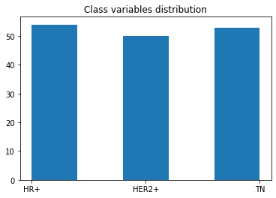
The data
We have 156 observation, 9135 Numeric features and 3045 Factor features
We have 3 response (cancer type) evenly distributed over the dataset

Slide 4
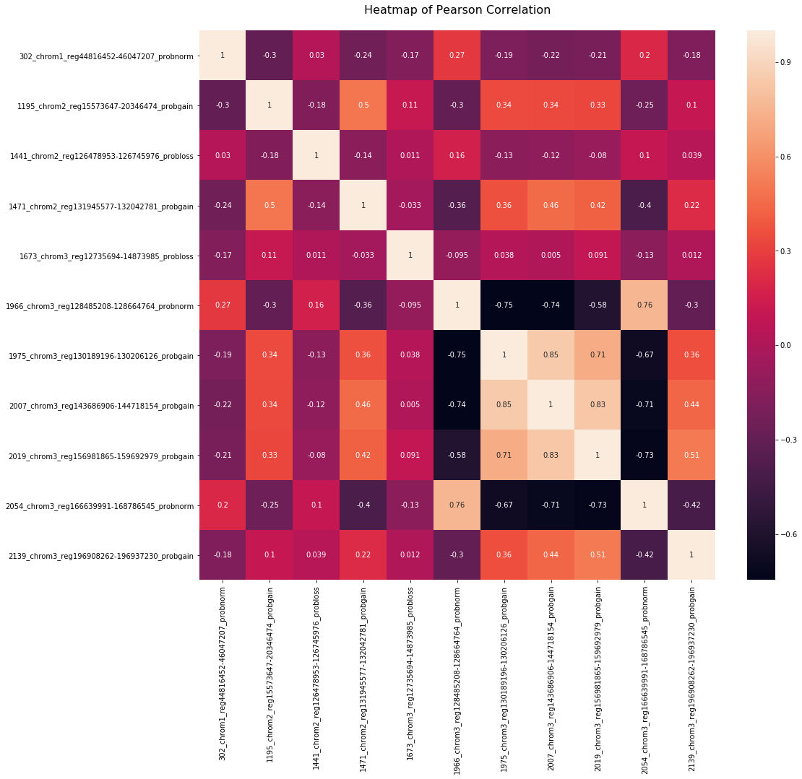
Pearson Correlation

Slide 5
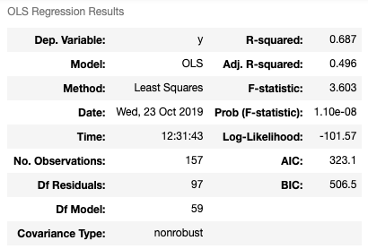
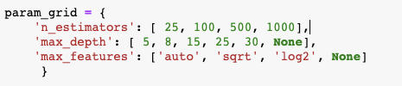
Random forest (RF)
Ordinary Least Square (OLS)
Parameter Tuning

Slide 6
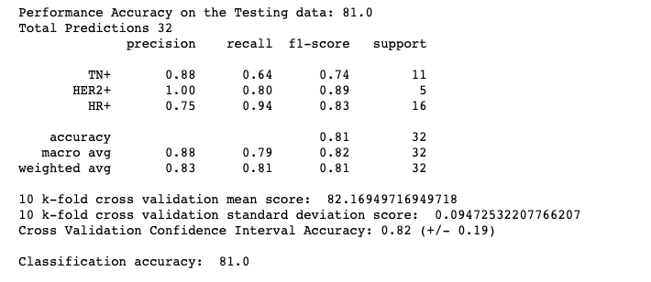
Random forest (RF)

Slide 7
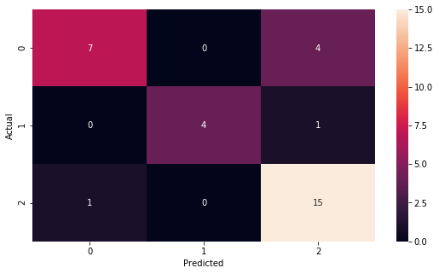
Random forest (RF)
Confusion Matrix

Slide 8
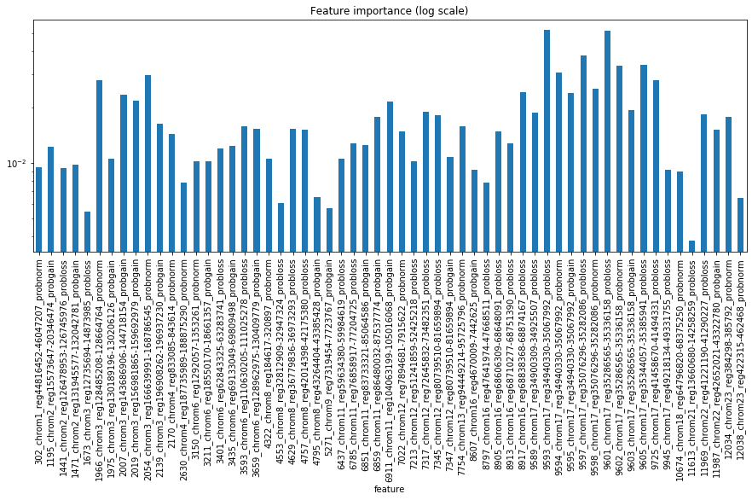
Random forest (RF)

Slide 9
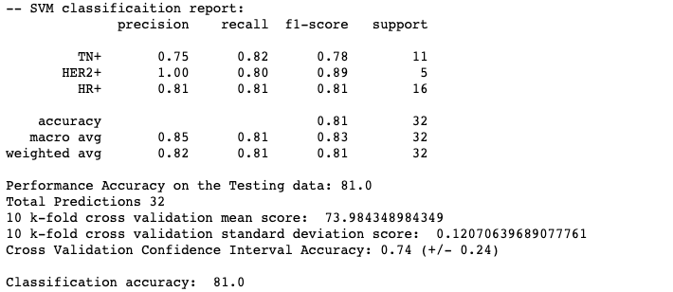
Support Vector Machine (SVM)

Slide 10
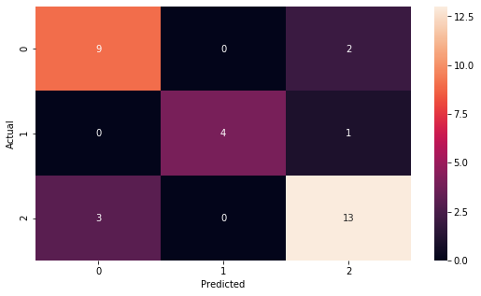
Support Vector Machine (SVM)
Confusion Matrix

Slide 11
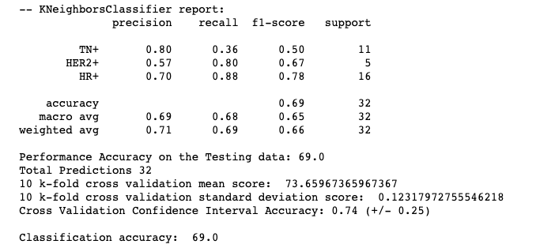
k-nearest neighbors algorithm (KNN)

Slide 12
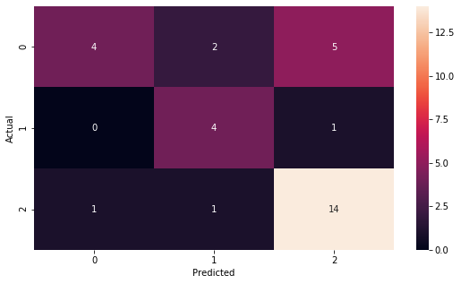
k-nearest neighbors algorithm (KNN)
Confusion Matrix

Slide 13
Summary
In this study, we started by understanding the data we prepared it for our needs to classify breast cancer type with three algorithms K-nearest neighbors (KNN), Support Vector Machine (SVM) and random forest RF. I focused more on the random forest algorithm because I thought it will perform the best but it had the same accuracy of 81% with SVM and KNN was the least performing with 69%

Slide 14
Perspective
Understand the data a bit more with more plots and research.
Make a proper comparison between the algorithm results.
Tune the algorithm parameters way much more, change the data set ratio (test/train)

Slide 15
Questions?

